Slide 1

DBA5103
Operations Research and Analytics
Zhenyu Hu
Semester I, 2026/2027

Slide 2
Dynamic Programming
Overview of DP
Deterministic DP
Stochastic DP

Slide 3
Overview of DP

Slide 4
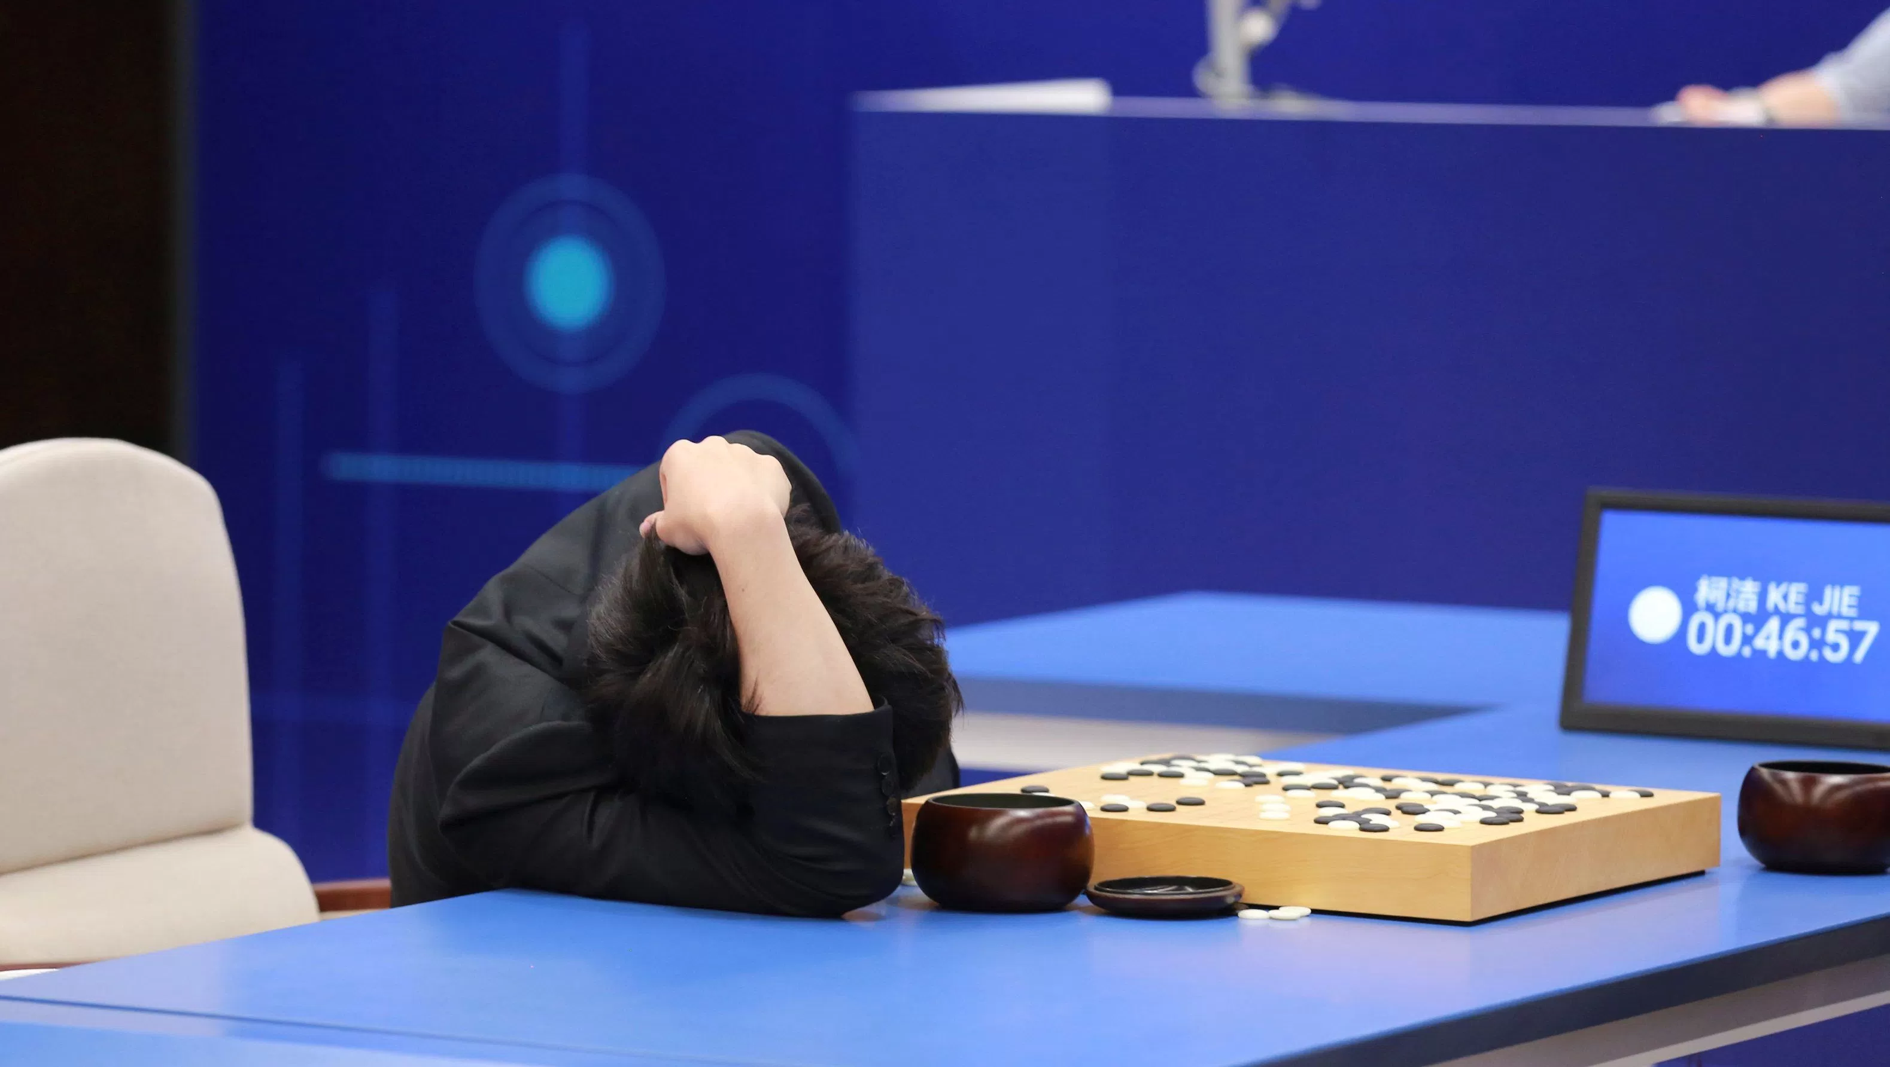
AlphaGo
Source: https://qz.com/993147/the-awful-frustration-of-a-teenage-go-champion-playing-googles-alphago/

Slide 5

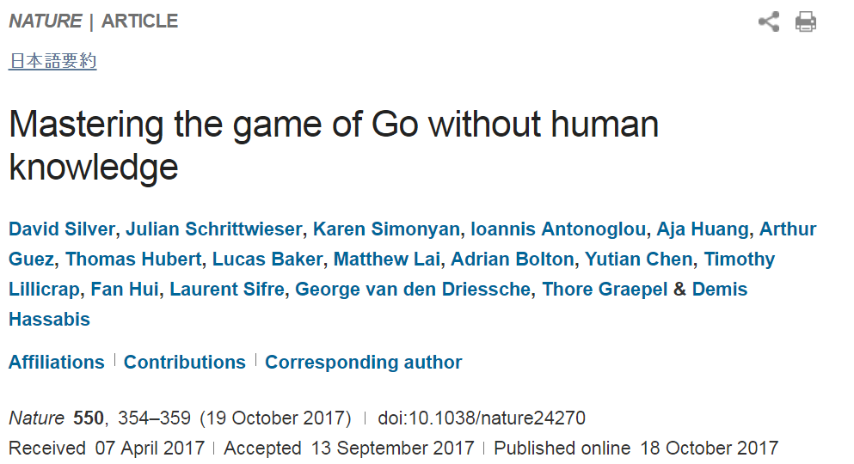
AlphaGo

Slide 6
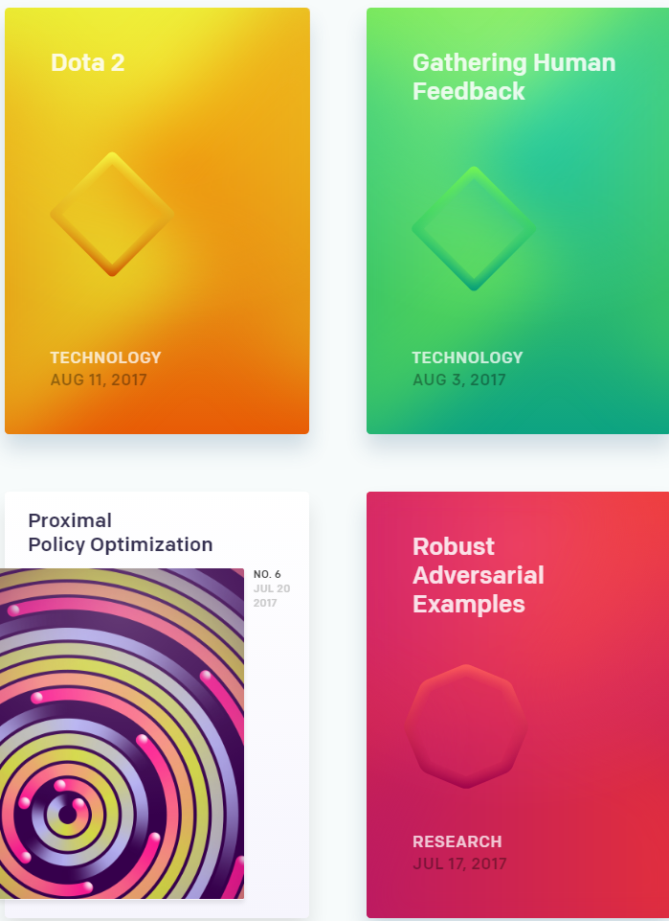
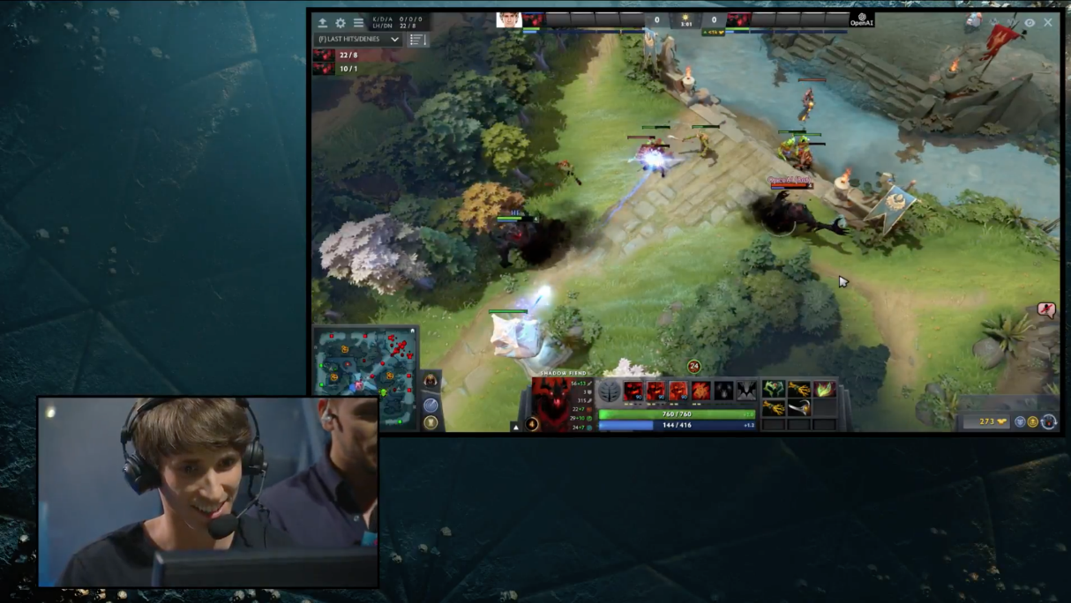
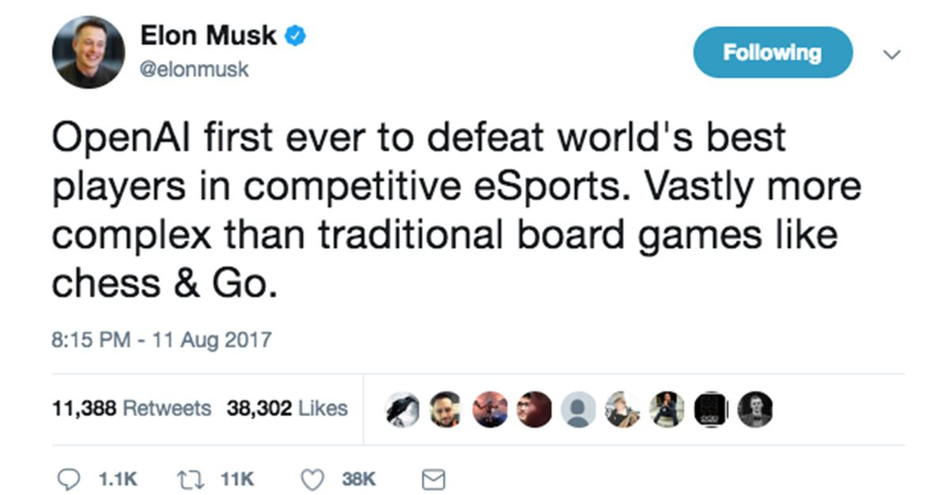
OpenAI
Source: https://blog.openai.com/dota-2/

Slide 7
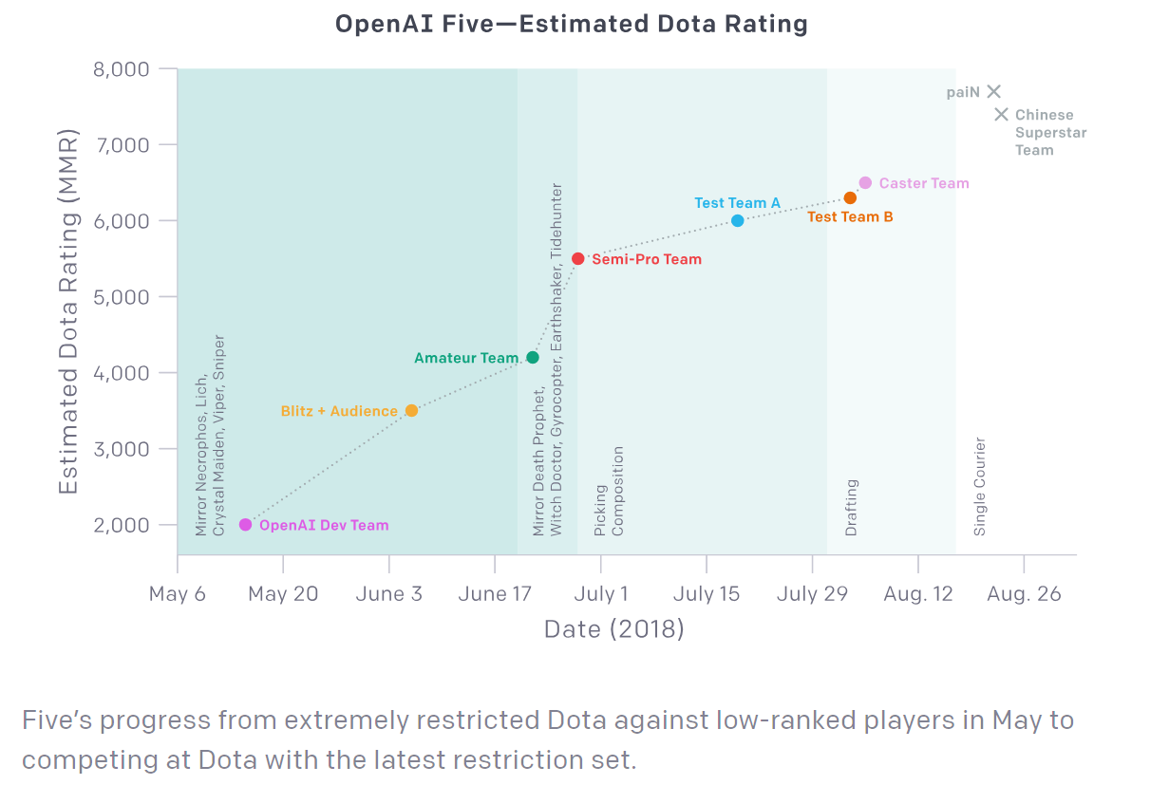
OpenAI
Source: https://openai.com/blog/the-international-2018-results/

Slide 8
Deterministic vs. Stochastic DP
Deterministic
  Used as a computational tool as well as modeling tool to various problems
  All solutions can be determined beforehand
Stochastic DP
  Commonly used to model sequential decision problems
  Solutions are determined sequentially as the randomness realize

Slide 9
Deterministic DP

Slide 10
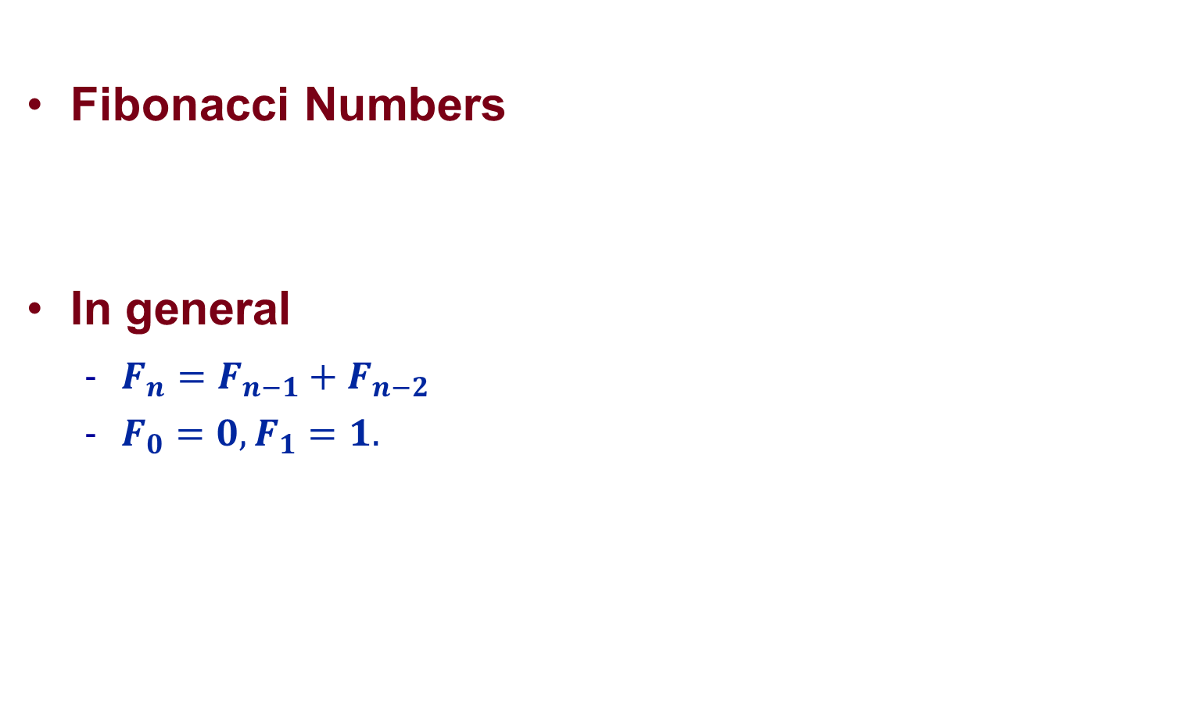
A Computational Point of View
Fibonacci Numbers
In general
  $F_{n}=F_{n−1}+F_{n−2}$
  $F_{0}=0, F_{1}=1.$
$$0, 1, 1, 2, 3, 5, 8, 13, 21, 34, 55, …$$

Slide 11
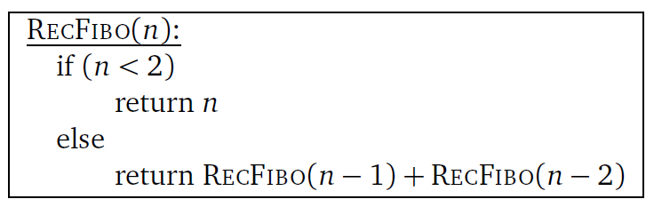
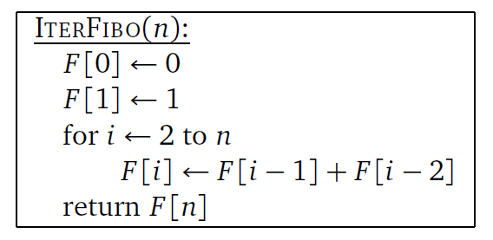
A Computational Point of View
Algorithm 1
Algorithm 2

Slide 12

First Algorithm: Tree View $n=5$
5
4
3
3
2
2
1
2
1
1
0
1
0
1
0
7 times of summation operations

Slide 13

Second Algorithm: Tree View $n=5$
5
4
3
3
2
2
1
2
1
1
0
1
0
1
0
4 times of summation operations

Slide 14
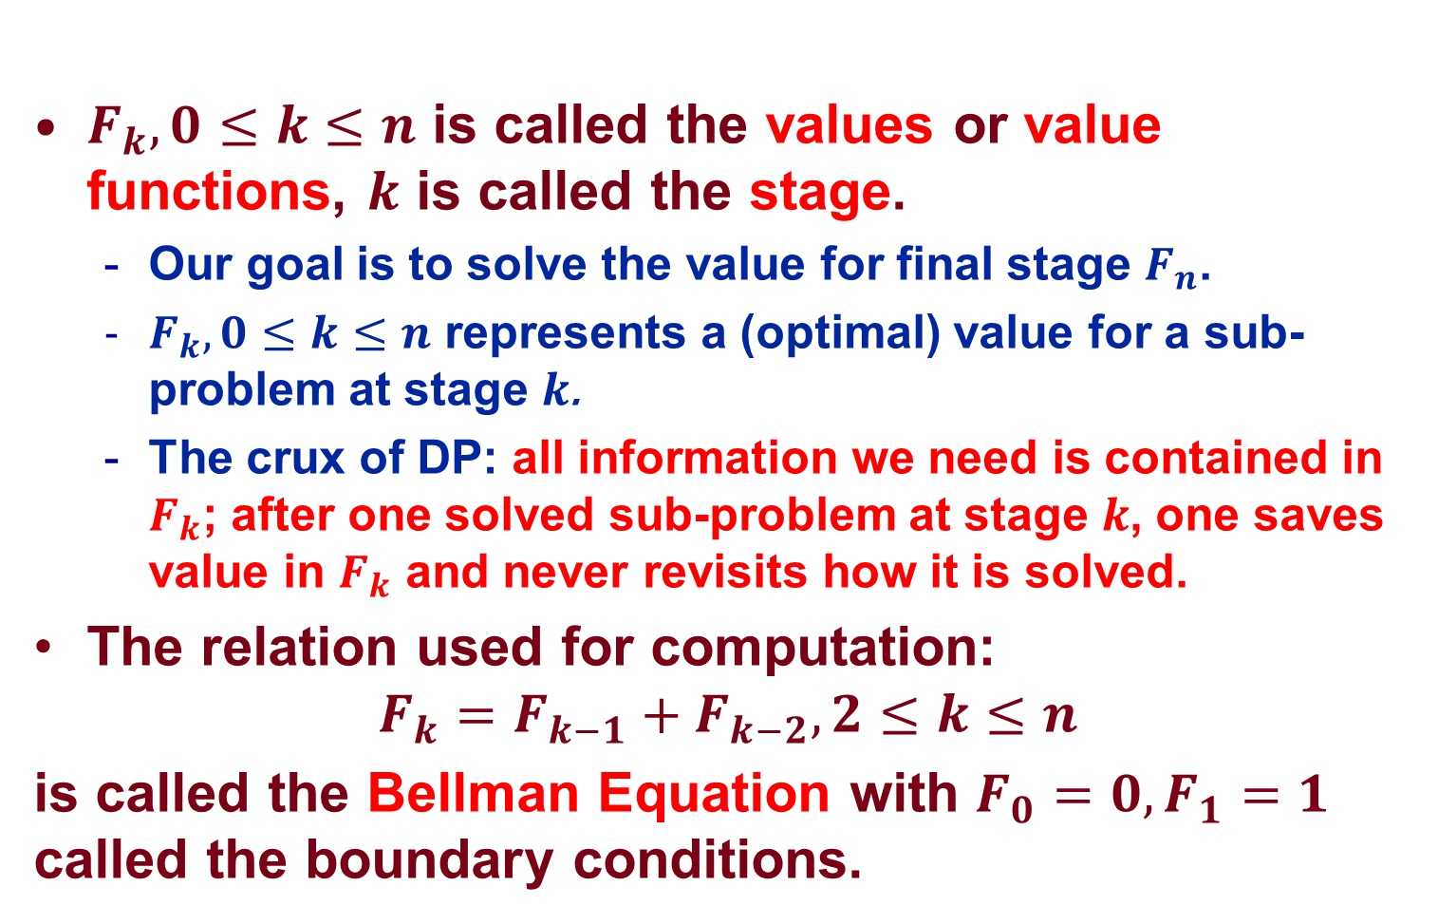
Key Idea: Value Function
$F_{k}, 0≤k≤n$ is called the values or value functions, $k$ is called the stage.
  Our goal is to solve the value for final stage $F_{n}$.
  $F_{k}, 0≤k≤n$ represents a (optimal) value for a sub-problem at stage $k$.
  The crux of DP: all information we need is contained in $F_{k}$; after one solved sub-problem at stage $k$, one saves value in $F_{k}$ and never revisits how it is solved.
The relation used for computation:
$$F_{k}=F_{k−1}+F_{k−2}, 2≤k≤n$$
is called the Bellman Equation with $F_{0}=0,F_{1}=1$ called the boundary conditions.

Slide 15
Shortest Path Problem
B
E
H
C
F
J
A
I
D
G

Slide 16
Cost on the Edges
 | B | C | D | E | F | G | H | I | J
A | 22 | 19 | 15
B |  |  |  | 16 | 15
C |  |  |  | 22 | 16 | 22
D |  |  |  |  | 19 | 22
E |  |  |  |  |  |  | 16 | 18
F |  |  |  |  |  |  | 18 | 11
G |  |  |  |  |  |  | 15 | 13
H |  |  |  |  |  |  |  |  | 23
I |  |  |  |  |  |  |  |  | 29

Slide 17
Decomposition
Stage 4
Stage 3
Stage 2
Stage 1
Stage 0
B
E
H
C
F
J
A
I
D
G

Slide 18
Decomposition
Stage 1
Stage 0
What is the shortest path from H to J?
What is the shortest path from I to J?
H
How do we save them down?
23
J
I
29

Slide 19
State
State: An information set upon which the decisions are based.
Finding a good state representation is the art of dynamic programming

Slide 20
State
Stage 4
Stage 3
Stage 2
Stage 1
Stage 0
B
States
E
H
C
F
J
A
I
D
G

Slide 21
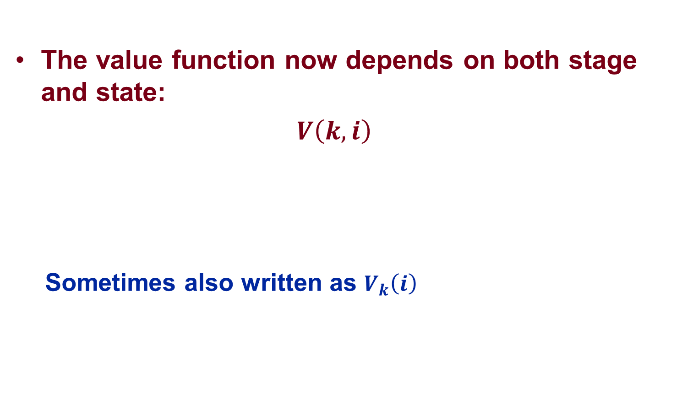
Value Function
The value function now depends on both stage and state:
$V\left(k, i\right)$
  Sometimes also written as $V_{k}\left(i\right)$
Stage k
State i

Slide 22



Stage 1
Stage 1
Stage 0
What is the shortest path from H to J?
$V\left(1,H\right)=23$
What is the shortest path from I to J?
H
How do we save them down?
23
J
I
29
$V\left(0,J\right)=0$
$V\left(1,I\right)=29$

Slide 23




Stage 2
Stage 2
Stage 1
Stage 0
$V\left(2,E\right)=39$
E
$V\left(1,H\right)=23$
16
H
18
$V\left(0,J\right)=0$
$V\left(2,F\right)=40$
23
18
J
F
11
29
I
15
G
$V\left(1,I\right)=29$
13
$V\left(2,G\right)=38$

Slide 24



Stage 3
Stage 3
Stage 2
Stage 1
Stage 0
$V\left(3,B\right)=55$
$V\left(2,E\right)=39$
B
E
16
$V\left(1,H\right)=23$
15
16
H
$V\left(3,C\right)=56$
18
$V\left(0,J\right)=0$
$V\left(2,F\right)=40$
22
18
J
C
16
F
11
22
I
19
15
D
G
$V\left(1,I\right)=29$
22
13
$V\left(3,D\right)=59$
$V\left(2,G\right)=38$

Slide 25

Final Stage
Stage 4
Stage 3
Stage 2
Stage 1
Stage 0
$V\left(3,B\right)=55$
B
E
H
$V\left(3,C\right)=56$
22
C
F
J
A
19
$V\left(4,A\right)=74$
I
15
D
G
$V\left(3,D\right)=59$

Slide 26



Solution
Stage 4
Stage 3
Stage 2
Stage 1
Stage 0
B
E
$V\left(1,H\right)=23$
H
22
$V\left(2,F\right)=40$
C
18
J
19
F
A
$V\left(4,A\right)=74$
11
29
I
$V\left(0,J\right)=0$
15
19
D
G
$V\left(1,I\right)=29$
22
$V\left(3,D\right)=59$
$V\left(2,G\right)=38$

Slide 27
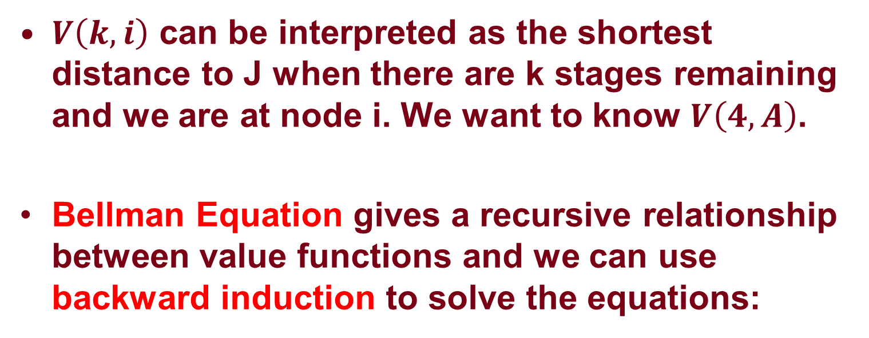
Shortest Path Problem: Summary
$V\left(k, i\right)$ can be interpreted as the shortest distance to J when there are k stages remaining and we are at node i. We want to know $V\left(4, A\right)$.
Bellman Equation gives a recursive relationship between value functions and we can use backward induction to solve the equations:
$V\left(k,i\right)=\min_{j, (i,j)∈A}\left\{c\left(i,j\right)+V\left(k−1, j\right)\right\}, V\left(0, J\right)=0$

Slide 28
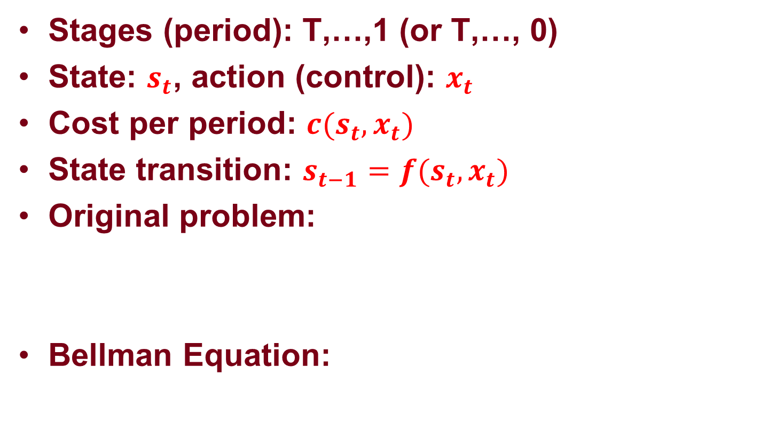
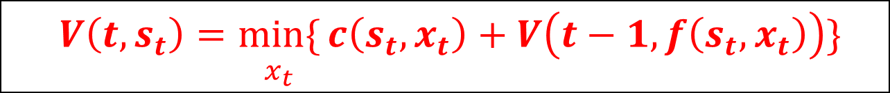
A General Deterministic DP
Stages (period): T,…,1 (or T,…, 0)
State: $s_{t}$, action (control): $x_{t}$
Cost per period: ${c(s}_{t}, x_{t})$
State transition: $s_{t−1}=f(s_{t},x_{t})$
Original problem:
Bellman Equation:
$\min_{x_{t}}\{{c\left(s_{T},x_{T}\right)+c\left(s_{T−1},x_{T−1}\right)+…+c\left(s_{1},x_{1}\right) \}}$
$V\left(t,s_{t}\right)=\underset{x_{t}}{min\{}{c\left(s_{t},x_{t}\right)+V\left(t−1,f\left(s_{t},x_{t}\right)\right)\}}$

Slide 29
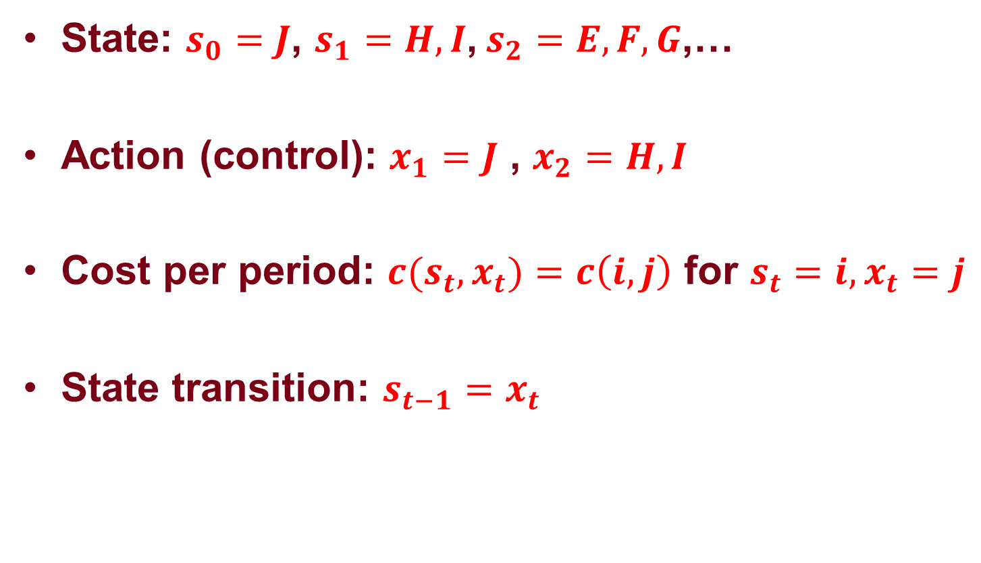
Shortest Path Problem
State: $s_{0}=J$, $s_{1}=H, I$, $s_{2}=E,F,G$,…
Action (control): $x_{1}=J$ , $x_{2}=H,I$
Cost per period: ${c(s}_{t}, x_{t})=c\left(i,j\right)$ for $s_{t}=i,x_{t}=j$
State transition: $s_{t−1}=x_{t}$

Slide 30
Summary: Components of DP
A problem is decomposed into n stages.
At stage k, we will have different possible states.
At each state, we focus only on the decision problem for the current stage and current state assuming all the sub-problems before stage k has been solved.
We call a mapping from each state to a decision the policy.

Slide 31
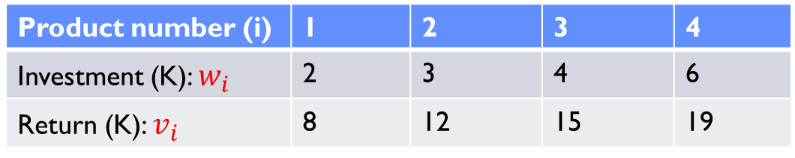
Knapsack Problem
Consider the investment problem with the following four financial products and a total budget of 10K.
Product number (i) | 1 | 2 | 3 | 4
Investment (K): $w_{i}$ | 2 | 3 | 4 | 6
Return (K): $v_{i}$ | 8 | 12 | 15 | 19

Slide 32
Think in a Sequential Way
Think about the case when the salesperson for product 1 to product 4 comes sequentially. At each stage, we have to make the decision whether to buy the product or not.
State:
The remaining budget.

Slide 33
Decomposition
Budget Available | Stage 4 | Stage 3 | Stage 2 | Stage 1
0
1
2
3
4
5
6
7
8
9
10

Slide 34


Single Stage Problem: Only Product 4
Budget Available | Stage 4 | Stage 3 | Stage 2 | Stage 1
0
1
2
3
4
5
6
7
8
9
10
$v_{4}=19, w_{4}=6$

Slide 35

Stage 1
Budget Available | Stage 4 | Stage 3 | Stage 2 | Stage 1
0 |  |  |  | 0
1 |  |  |  | 0
2 |  |  |  | 0
3 |  |  |  | 0
4 |  |  |  | 0
5 |  |  |  | 0
6 |  |  |  | 19
7 |  |  |  | 19
8 |  |  |  | 19
9 |  |  |  | 19
10 |  |  |  | 19
$v_{4}=19, w_{4}=6$

Slide 36

Stage 2
Budget Available | Stage 4 | Stage 3 | Stage 2 | Stage 1
0 |  |  |  | 0
1 |  |  |  | 0
2 |  |  |  | 0
3 |  |  |  | 0
4 |  |  |  | 0
5 |  |  |  | 0
6 |  |  |  | 19
7 |  |  |  | 19
8 |  |  |  | 19
9 |  |  |  | 19
10 |  |  |  | 19
$v_{3}=15, w_{3}=4$

Slide 37
Stage 2
Budget Available | Stage 4 | Stage 3 | Stage 2 | Stage 1
0 |  |  | 0 | 0
1 |  |  | 0 | 0
2 |  |  | 0 | 0
3 |  |  | 0 | 0
4 |  |  | 15 | 0
5 |  |  | 15 | 0
6 |  |  | 19 | 19
7 |  |  | 19 | 19
8 |  |  | 19 | 19
9 |  |  | 19 | 19
10 |  |  | 34 | 19
$v_{3}=15, w_{3}=4$

Slide 38

Stage 3
Budget Available | Stage 4 | Stage 3 | Stage 2 | Stage 1
0 |  |  | 0 | 0
1 |  |  | 0 | 0
2 |  |  | 0 | 0
3 |  |  | 0 | 0
4 |  |  | 15 | 0
5 |  |  | 15 | 0
6 |  |  | 19 | 19
7 |  |  | 19 | 19
8 |  |  | 19 | 19
9 |  |  | 19 | 19
10 |  |  | 34 | 19
$v_{2}=12, w_{2}=3$

Slide 39
Stage 3
Budget Available | Stage 4 | Stage 3 | Stage 2 | Stage 1
0 |  | 0 | 0 | 0
1 |  | 0 | 0 | 0
2 |  | 0 | 0 | 0
3 |  | 12 | 0 | 0
4 |  | 15 | 15 | 0
5 |  | 15 | 15 | 0
6 |  | 19 | 19 | 19
7 |  | 27 | 19 | 19
8 |  | 27 | 19 | 19
9 |  | 31 | 19 | 19
10 |  | 34 | 34 | 19
$v_{2}=12, w_{2}=3$

Slide 40

Final Stage
Budget Available | Stage 4 | Stage 3 | Stage 2 | Stage 1
0 |  | 0 | 0 | 0
1 |  | 0 | 0 | 0
2 |  | 0 | 0 | 0
3 |  | 12 | 0 | 0
4 |  | 15 | 15 | 0
5 |  | 15 | 15 | 0
6 |  | 19 | 19 | 19
7 |  | 27 | 19 | 19
8 |  | 27 | 19 | 19
9 |  | 31 | 19 | 19
10 |  | 34 | 34 | 19
$v_{1}=8, w_{1}=2$

Slide 41
Final Stage
Budget Available | Stage 4 | Stage 3 | Stage 2 | Stage 1
0 | 0 | 0 | 0 | 0
1 | 0 | 0 | 0 | 0
2 | 8 | 0 | 0 | 0
3 | 12 | 12 | 0 | 0
4 | 15 | 15 | 15 | 0
5 | 20 | 15 | 15 | 0
6 | 23 | 19 | 19 | 19
7 | 27 | 27 | 19 | 19
8 | 27 | 27 | 19 | 19
9 | 35 | 31 | 19 | 19
10 | 35 | 34 | 34 | 19
$v_{1}=8, w_{1}=2$

Slide 42

Complete Solution
Budget Available | Stage 4 | Stage 3 | Stage 2 | Stage 1
0 | 0 | 0 | 0 | 0
1 | 0 | 0 | 0 | 0
2 | 8 | 0 | 0 | 0
3 | 12 | 12 | 0 | 0
4 | 15 | 15 | 15 | 0
5 | 20 | 15 | 15 | 0
6 | 23 | 19 | 19 | 19
7 | 27 | 27 | 19 | 19
8 | 27 | 27 | 19 | 19
9 | 35 | 31 | 19 | 19
10 | 35 | 34 | 34 | 19
$v_{1}=8, w_{1}=2$
$v_{2}=12, w_{2}=3$
$v_{3}=15, w_{3}=4$
$v_{4}=19, w_{4}=6$

Slide 43
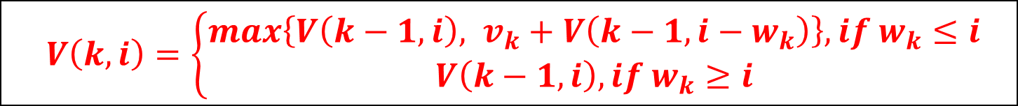
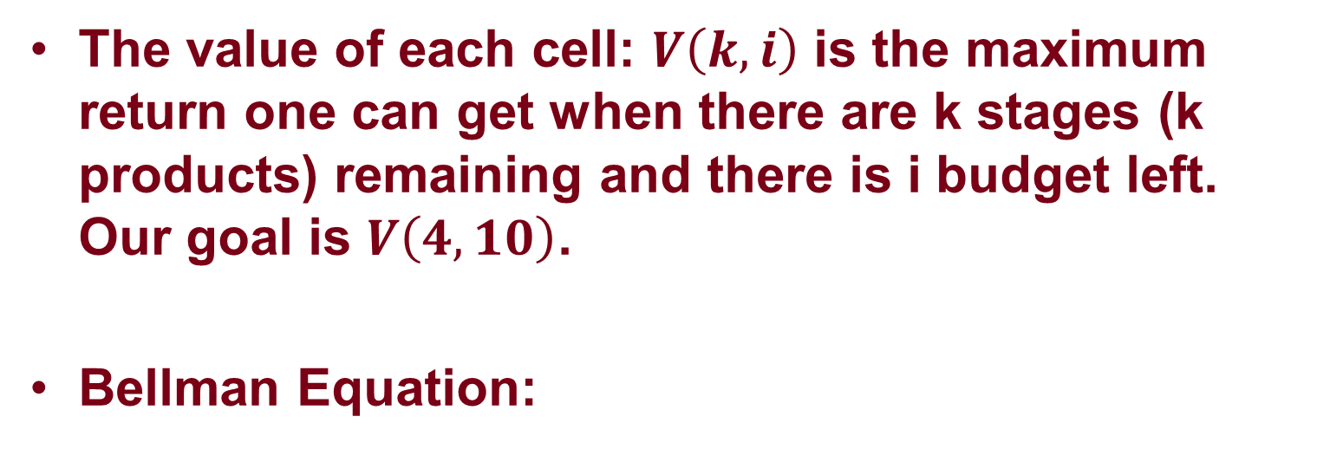
Knapsack Problem: Bellman Equation
The value of each cell: $V\left(k, i\right)$ is the maximum return one can get when there are k stages (k products) remaining and there is i budget left. Our goal is $V\left(4, 10\right)$.
Bellman Equation:
$V\left(k,i\right)=\left\{\begin{aligned}max\left\{V\left(k−1, i\right), v_{k}+V\left(k−1,i−w_{k}\right)\right\}, if w_{k}≤i \\ V\left(k−1, i\right), if w_{k}≥i\end{aligned}\right.$
$$V\left(0, i\right)=0,i=1,…,10$$

Slide 44
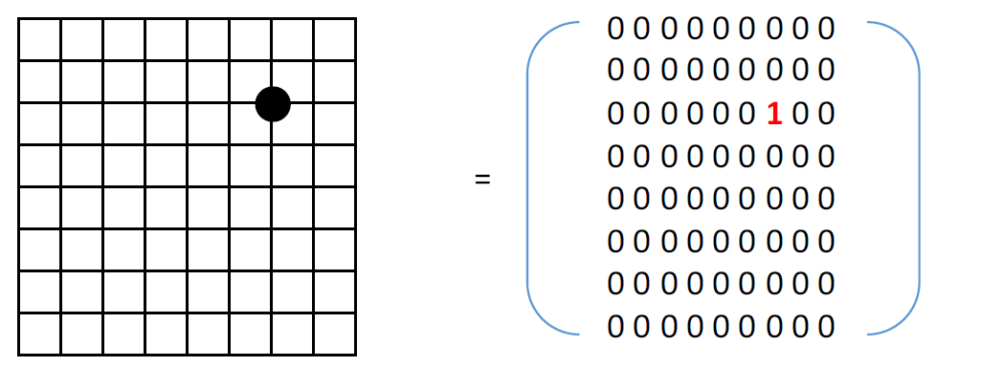
A Very Complicated Dynamic Problem: Go
Zero-sum, perfect-information, deterministic game
State?
Notes:
19 X 19 for standard games with 9X9 for beginners

Slide 45
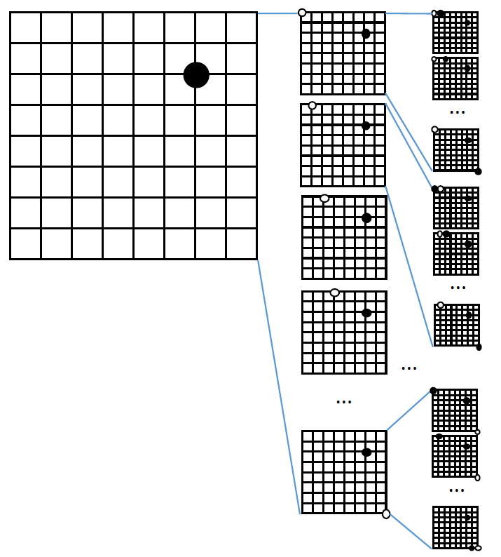
State Transition

Slide 46
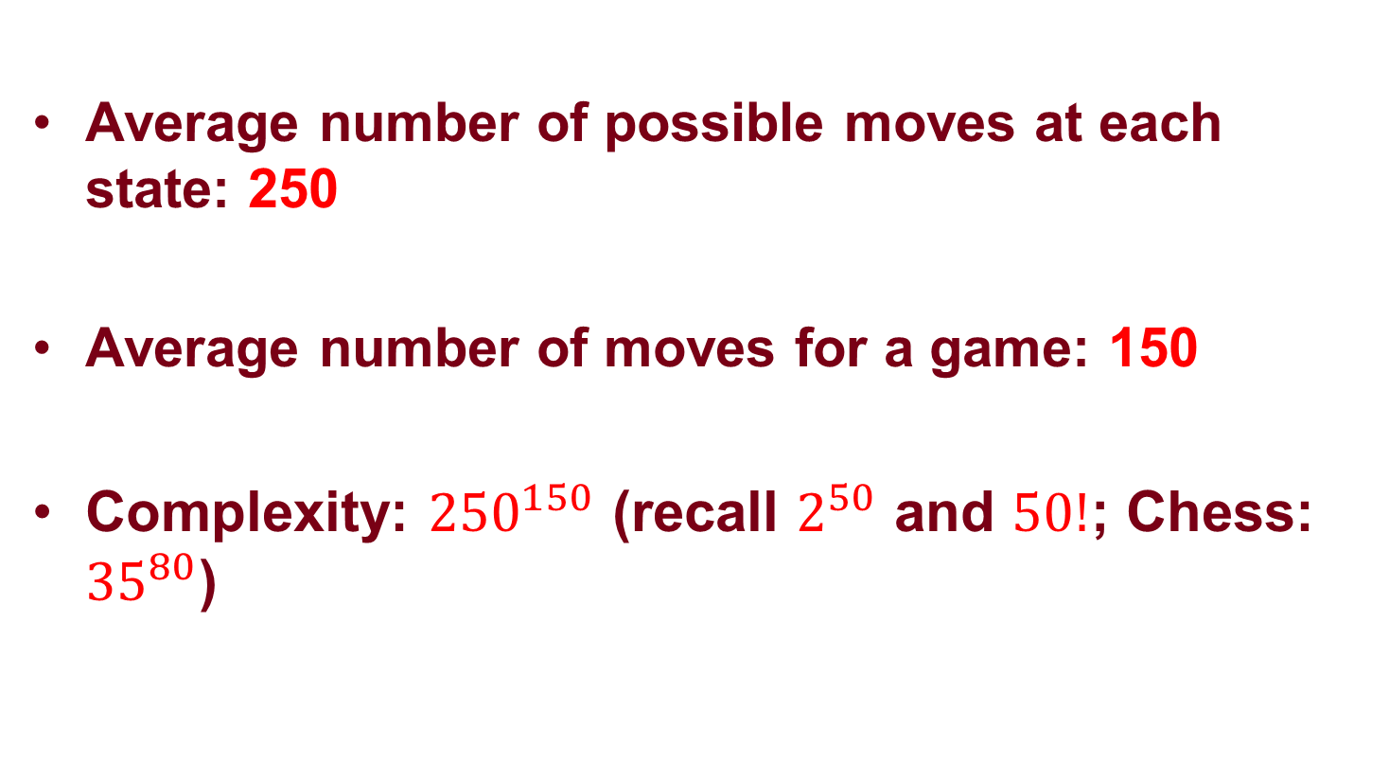
Rough Estimate of Complexity
Average number of possible moves at each state: 250
Average number of moves for a game: 150
Complexity: ${250}^{150}$ (recall $2^{50}$ and $50!$; Chess: ${35}^{80}$)

Slide 47
Stochastic DP

Slide 48
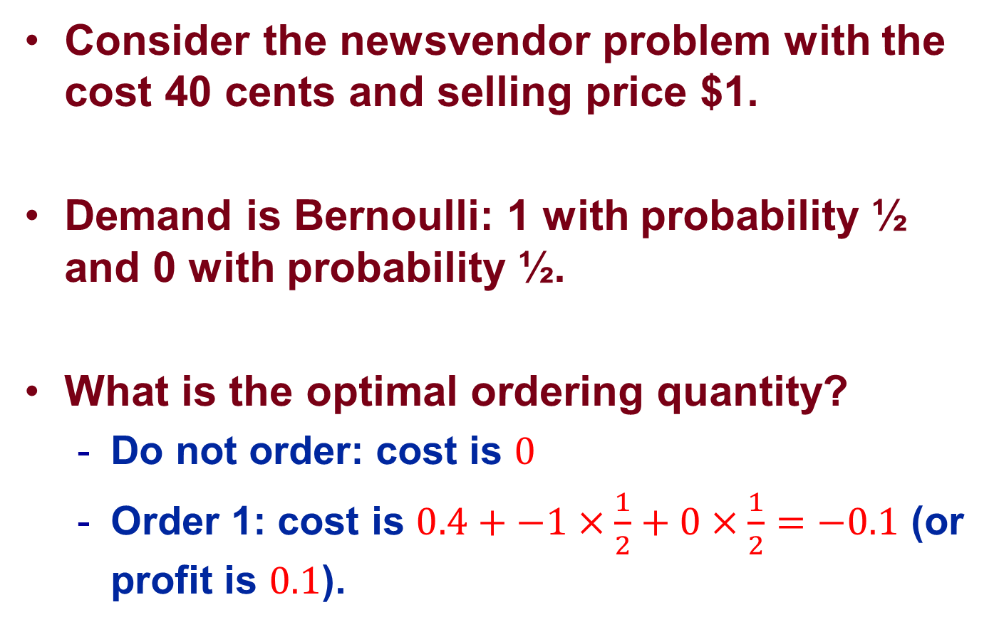
Newsvendor Problem
Consider the newsvendor problem with the cost 40 cents and selling price $1.
Demand is Bernoulli: 1 with probability ½ and 0 with probability ½.
What is the optimal ordering quantity?
  Do not order: cost is $0$
  Order 1: cost is $0.4+−1×\frac{1}{2}+0×\frac{1}{2}=−0.1$ (or profit is $0.1$).

Slide 49
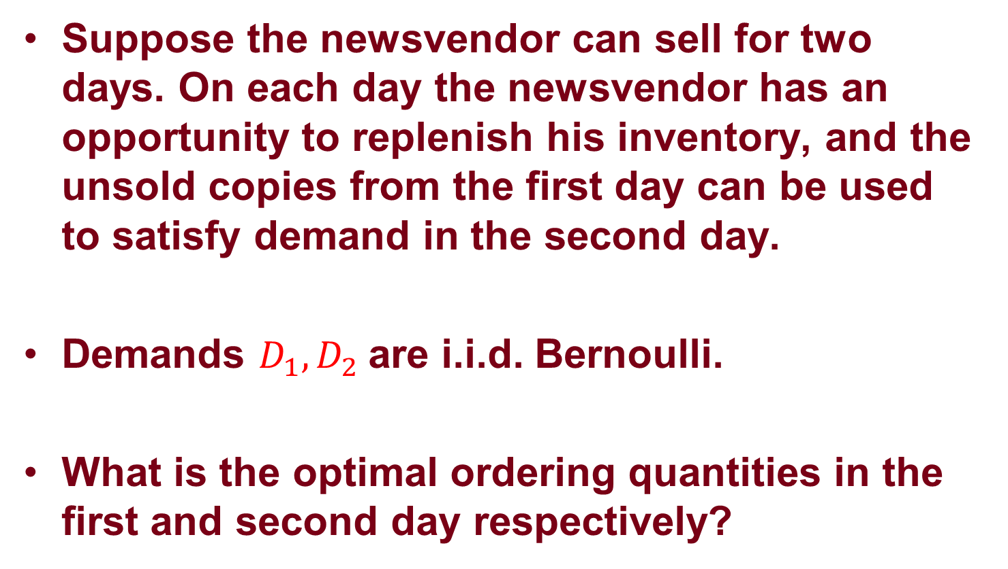
Multi-Period Newsvendor Problem
Suppose the newsvendor can sell for two days. On each day the newsvendor has an opportunity to replenish his inventory, and the unsold copies from the first day can be used to satisfy demand in the second day.
Demands $D_{1},D_{2}$are i.i.d. Bernoulli.
What is the optimal ordering quantities in the first and second day respectively?

Slide 50
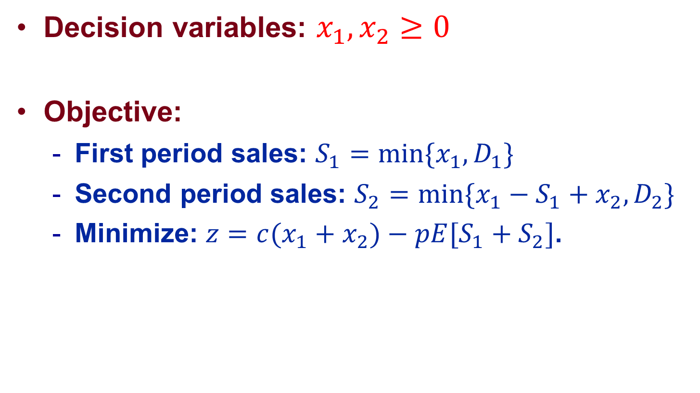
Stochastic Optimization
Decision variables: $x_{1},x_{2}≥0$
Objective:
  First period sales: ${S_{1}=min⁡\{x}_{1},D_{1}\}$
  Second period sales: ${S_{2}=min⁡\{x}_{1}−S_{1}+x_{2},D_{2}\}$
  Minimize: ${z=c(x}_{1}+x_{2})−pE[S_{1}+S_{2}]$.

Slide 51
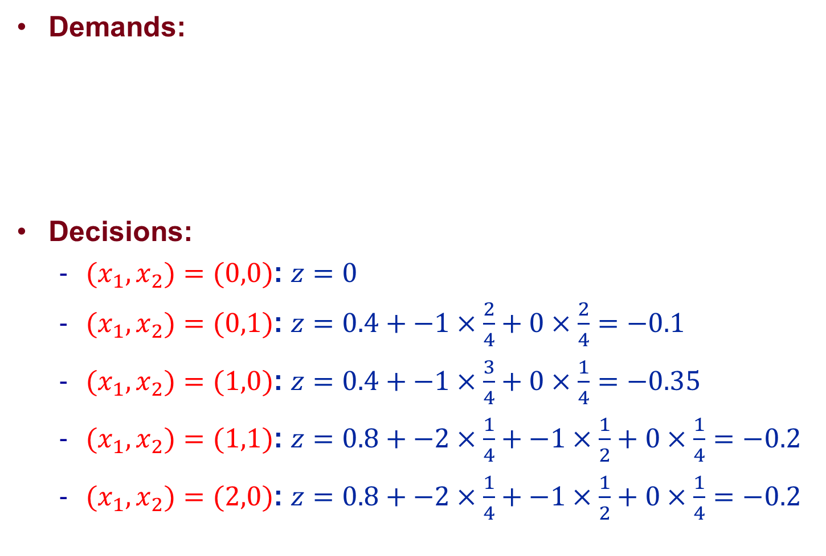
Stochastic Optimization
Demands:
Decisions:
  ${(x}_{1},x_{2})=(0,0)$: $z=0$
  ${(x}_{1},x_{2})=(0,1)$: $z=0.4+−1×\frac{2}{4}+0×\frac{2}{4}=−0.1$
  ${(x}_{1},x_{2})=(1,0)$: $z=0.4+−1×\frac{3}{4}+0×\frac{1}{4}=−0.35$
  ${(x}_{1},x_{2})=(1,1)$: $z=0.8+−2×\frac{1}{4}+−1×\frac{1}{2}+0×\frac{1}{4}=−0.2$
  ${(x}_{1},x_{2})=(2,0)$: $z=0.8+−2×\frac{1}{4}+−1×\frac{1}{2}+0×\frac{1}{4}=−0.2$
Demand (Day 1) | Demand (Day 2) | Probability
0 | 0 | ¼
0 | 1 | ¼
1 | 0 | ¼
1 | 1 | ¼

Slide 52
Open-loop Solution
The optimal solution is to order 1 unit in the first day and order nothing in the second day.
The expected profit is 35 cents.
Information flow is not utilized in making decisions.

Slide 53
Stochastic Shortest Path Formulation
Stage 3
Stage 2
Stage 1
Stage 0
0
0
0
0
0
0
0
0
0
0
0
0.4
-1, p=1/2
0.4
-1, p=1/2
0
0, p=1/2
0
0, p=1/2
0.8
1
1
1
1
0
-1, p=1/2
-1, p=1/2
0, p=1/2
0
0, p=1/2
2
2
2
2

Slide 54



Stage 2 (Day 2)
Stage 2
Stage 1
$V\left(2,0\right)=min\left\{0+0, 0.4+\left(−1×\frac{1}{2}+0×\frac{1}{2}\right)+0×\frac{1}{2}+0×\frac{1}{2}\right\}=−0.1$
$V\left(1,0\right)=0$
0
0
0
0
0
0.4
-1, p=1/2
0
0, p=1/2
$V\left(1,1\right)=0$
1
1
1
$V\left(2,1\right)=0+\left(−1×\frac{1}{2}+0×\frac{1}{2}\right)+0×\frac{1}{2}+0×\frac{1}{2}=−0.5$
-1, p=1/2
0
0, p=1/2
2
2
2
$V\left(1,2\right)=0$
$V\left(2,2\right)=0+\left(−1×\frac{1}{2}+0×\frac{1}{2}\right)+0×\frac{1}{2}+0×\frac{1}{2}=−0.5$

Slide 55




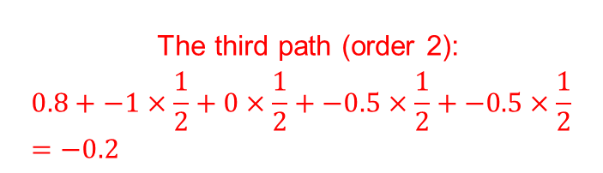

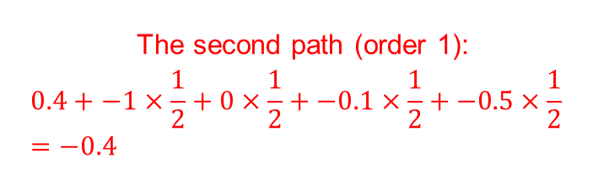
Last Stage (Day 1)
Stage 3
Stage 2
$V\left(3,0\right)=−0.4$
$V\left(2,0\right)=−0.1$
The first path (do not order):
$$0−0.1=−0.1$$
0
0
0
0
0
0.4
-1, p=1/2
$V\left(2,1\right)=−0.5$
0, p=1/2
The second path (order 1):
$$0.4+−1×\frac{1}{2}+0×\frac{1}{2}+−0.1×\frac{1}{2}+−0.5×\frac{1}{2}=−0.4$$
0.8
1
1
-1, p=1/2
0, p=1/2
$V\left(2,2\right)=−0.5$
2
2
The third path (order 2):
$$0.8+−1×\frac{1}{2}+0×\frac{1}{2}+−0.5×\frac{1}{2}+−0.5×\frac{1}{2}=−0.2$$

Slide 56
Optimal Policy
Stage 3
Stage 2
Stage 1
Stage 0
0
0
0
0
0
0
0
0
0
0
0
0.4
-1, p=1/2
0.4
-1, p=1/2
0
0, p=1/2
0
0, p=1/2
0.8
1
1
1
1
0
-1, p=1/2
-1, p=1/2
0, p=1/2
0
0, p=1/2
2
2
2
2

Slide 57
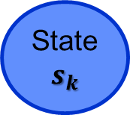
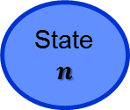
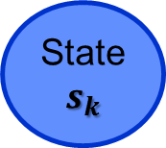

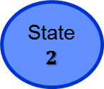
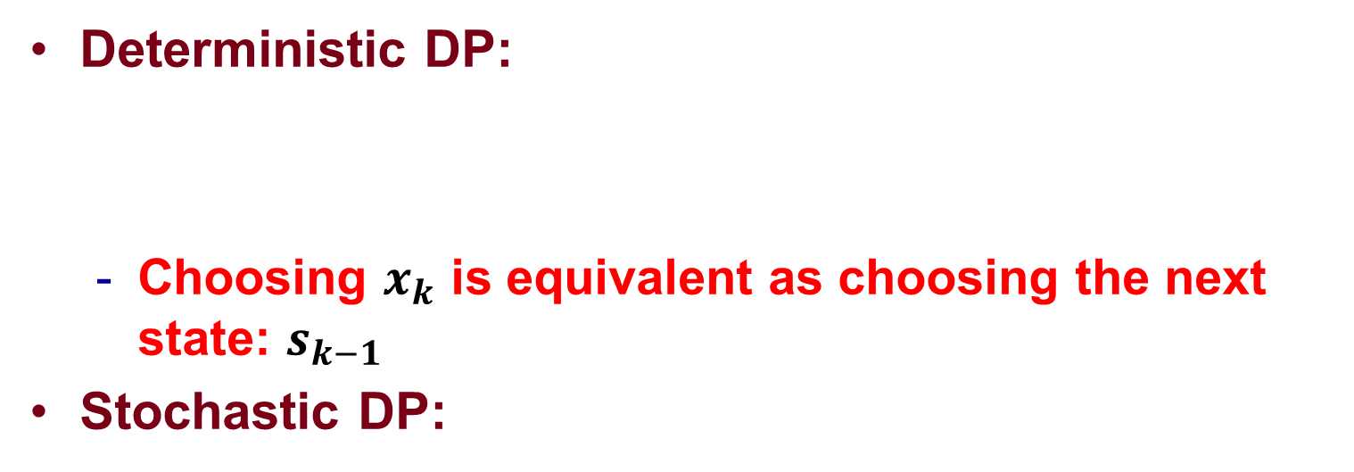
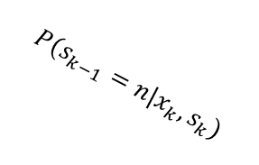
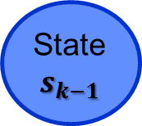

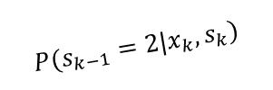

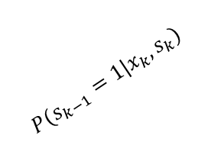
Deterministic DP vs Stochastic DP
Deterministic DP:
  Choosing $x_{k}$ is equivalent as choosing the next state: $s_{k−1}$
Stochastic DP:
State
$$s_{k}$$
Action: $x_{k}$
State
$$s_{k−1}$$
State
$$1$$
${P(s}_{k−1}=1|x_{k},s_{k})$
State
$$2$$
State
$$s_{k}$$
${P(s}_{k−1}=2|x_{k},s_{k})$
Action: $x_{k}$
${P(s}_{k−1}=n|x_{k},s_{k})$
State
$$n$$

Slide 58
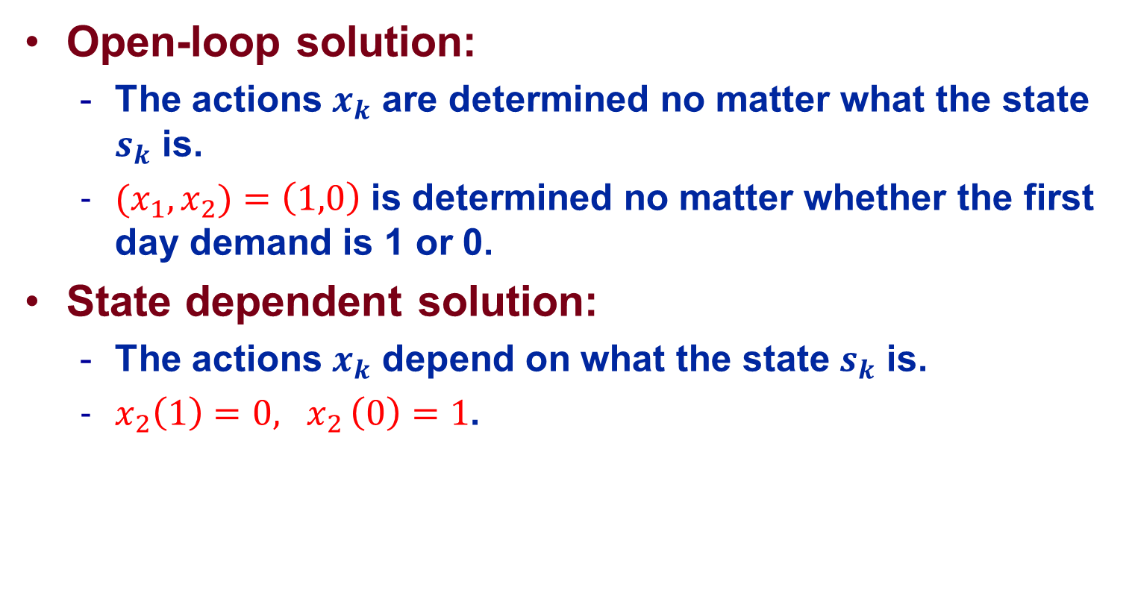
Open-loop vs State Dependent Solution
Open-loop solution:
  The actions $x_{k}$ are determined no matter what the state $s_{k}$ is.
  ${(x}_{1},x_{2})=\left(1,0\right)$ is determined no matter whether the first day demand is 1 or 0.
State dependent solution:
  The actions $x_{k}$ depend on what the state $s_{k}$ is.
  $x_{2}\left(1\right)=0{, x}_{2}\left(0\right)=1$.

Slide 59
Secretary Problem
There is a single secretary position to fill
There are n applicants for the position
The applicants, if seen altogether, can be ranked from best to worst.
Applicants are interviewed sequentially in random order with each order being equally likely.
After an interview, an offer or rejection must be made, based on the applicants interviewed so far.
Objective is to choose the best candidate:
  Maximize the probability that the chosen candidate is the best

Slide 60
Naïve Method: Open-loop Solution
Before the interviews begin, choose the k-th applicant, k = 1,…,n such that the probability of selecting the best candidate is maximized.
What is the best k and what is the optimal probability ?
Information flow is not utilized in making decisions.

Slide 61
Stochastic DP
State:
  It is sufficient to know whether or not the current applicant is the best among all those interviewed before. Suppose 0 means it is not the best, 1 means it is the best.

Slide 62


Stage 0 (the n-th candidate)
Stage 0
$V\left(0,0\right)=0$
0
1
$V\left(0,1\right)=1$

Slide 63


Stage 1 (the n-1-th candidate)
Stage 1
Stage 0
$V\left(1,0\right)=max \{0,\frac{1}{n}V\left(0, 1\right)+ \frac{n−1}{n}V\left(0,0\right)\}=\frac{1}{n}$
$V\left(0,0\right)=0$
p=?
0
Reject
0
Offer
value?
Offer
1
Reject
1
$V\left(0,1\right)=1$
$V\left(1,1\right)=max \{\frac{n−1}{n},\frac{1}{n}V\left(0, 1\right)+ \frac{n−1}{n}V\left(0,0\right)\}=\frac{n−1}{n}$

Slide 64
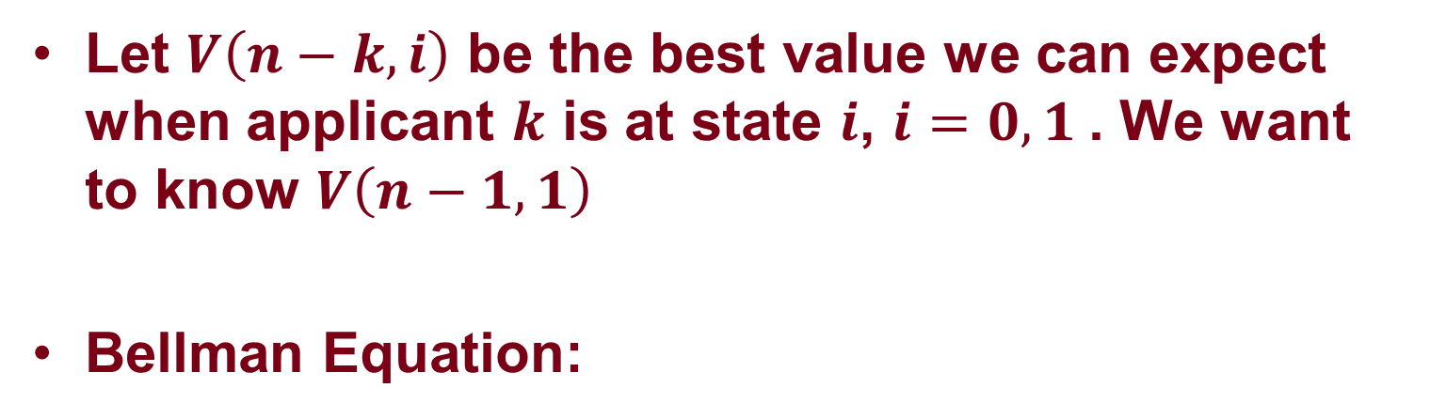

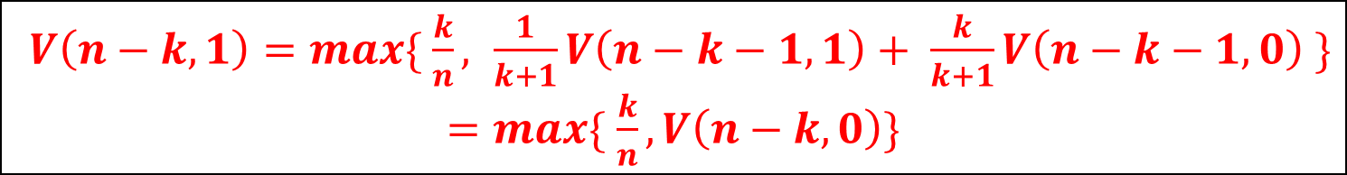
Stage n-k (the k-th candidate)
Let $V\left(n−k, i\right)$ be the best value we can expect when applicant $k$ is at state $i$, $i=0,1$. We want to know $V\left(n−1, 1\right)$
Bellman Equation:
$V\left(n−k,0\right)=max\{ 0,\frac{1}{k+1}V\left(n−k−1, 1\right)+ \frac{k}{k+1}V\left(n−k−1,0\right)\}$
$V\left(n−k,1\right)=max\{ \frac{k}{n}, \frac{1}{k+1}V\left(n−k−1, 1\right)+ \frac{k}{k+1}V\left(n−k−1,0\right) \}$ $=max\{ \frac{k}{n},V\left(n−k,0\right)\}$
$V\left(0,0\right)=0,V\left(0,1\right)=1$

Slide 65
Secretary Problem: n = 4
k = 4
k = 3
k = 2
k = 1
1: Reject; 2-4: Accept if the best seen so far.
$V\left(0,0\right)=0, V\left(0,1\right)=1$
$V\left(1,0\right)= \frac{1}{4}1+ \frac{3}{4}0=\frac{1}{4}, V\left(1,1\right)=max\left\{\frac{3}{4},\frac{1}{4}\right\}=\frac{3}{4}$
$V\left(2,0\right)= \frac{1}{3}\frac{3}{4}+ \frac{2}{3}\frac{1}{4}=\frac{5}{12}, V\left(2,1\right)=max\left\{\frac{2}{4},\frac{5}{12}\right\}=\frac{1}{2}$
$V\left(3,0\right)= \frac{1}{2}\frac{1}{2}+ \frac{1}{2}\frac{5}{12}=\frac{11}{24}, V\left(3,1\right)=max\left\{\frac{1}{4},\frac{11}{24}\right\}=\frac{11}{24}$

Slide 66
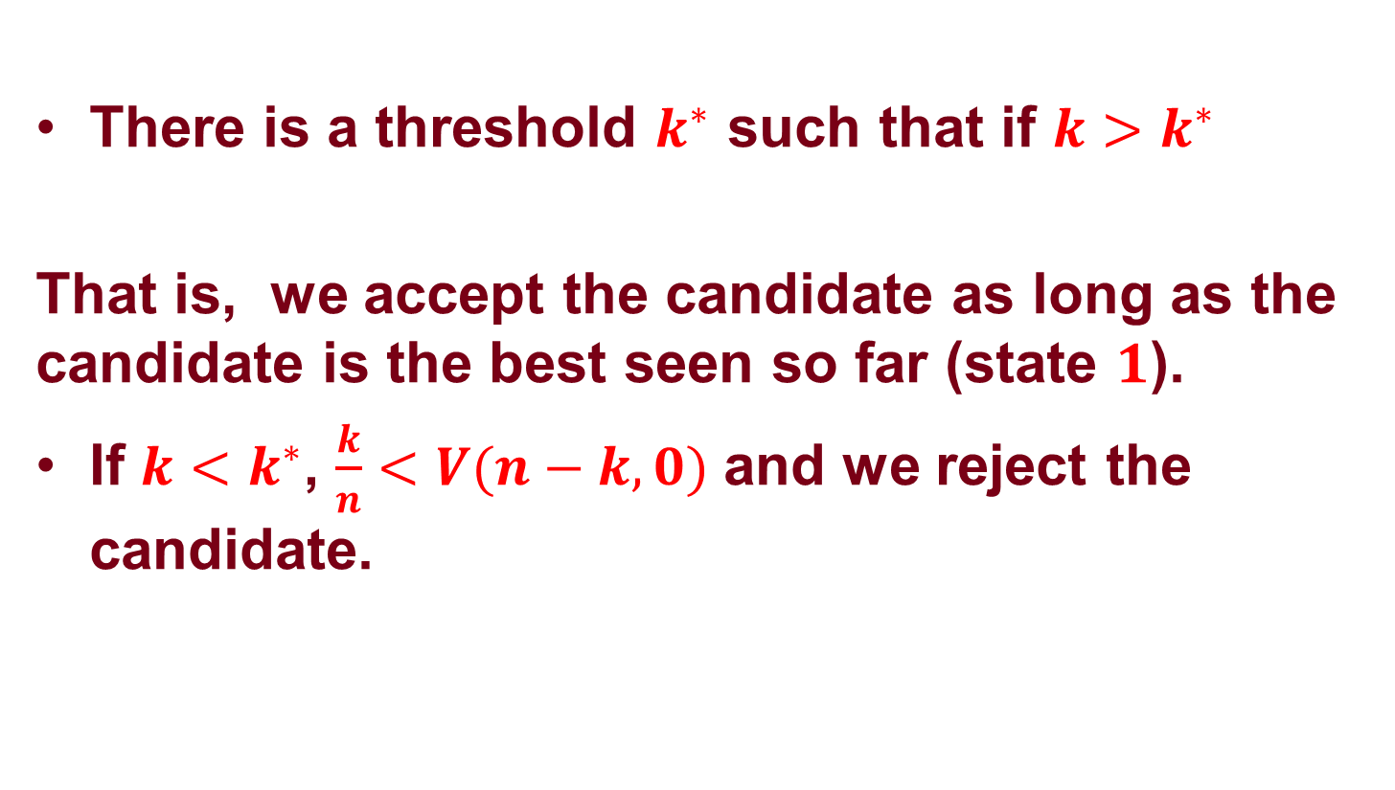
Secretary Problem: In General
There is a threshold $k^{∗}$ such that if ${k>k}^{∗}$
That is, we accept the candidate as long as the candidate is the best seen so far (state $1$).
If ${k<k}^{∗}$, $\frac{k}{n}<V(n−k,0)$ and we reject the candidate.
$\frac{k}{n}≥V(n−k,0)$
$$k^{∗}≈\frac{1}{e}n≈0.37n$$

Slide 67
Review

Slide 68
What You Should Expect
Mathematical Thinking
  Understand the basic logic behind algorithms
    Simplex (BFS, local search, spanning tree)
    Branch and Bound (relaxation, bounding)
    Dynamic Programming (state, value function)
  Understand the general principles in optimization
    Convex vs. non-convex (global vs. local)
    Deterministic vs. stochastic (hedging risk, value of information)
    Lagrangian relaxation, duality, lower bound/upper bound
  Judgement on the difficulty of a problem; be able to assess the quality of a solution
    Problem size/type; exponential vs. polynomial
    Relaxation and bounding

Slide 69
What You Should Expect
Analytics Skills
  Building up models
    LP: production-type problem, simple pricing and sourcing problem
    Network flow: project management, process flexibility, transportation and matching
    IP: multi-product pricing, routing and scheduling, Sudoku
    DP: shortest path problem, inventory problem, optimal stopping
  Picking the right tools
  Implementing in Software

